Slide 1


Slide 2
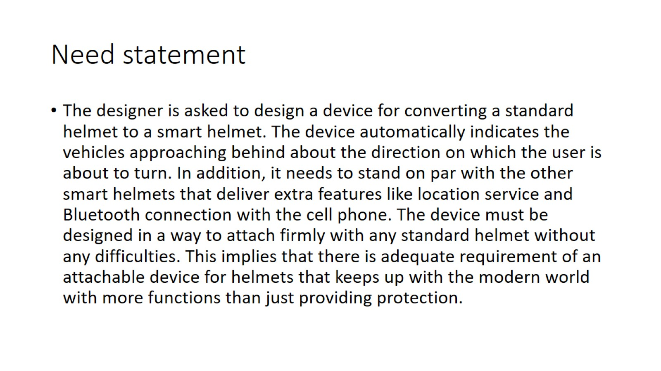
Need statement

Slide 3
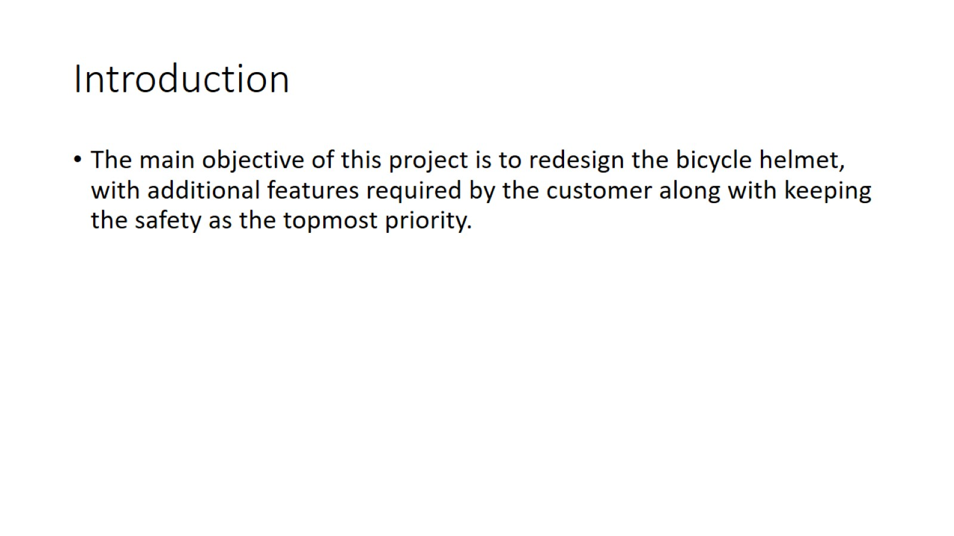
Introduction

Slide 4
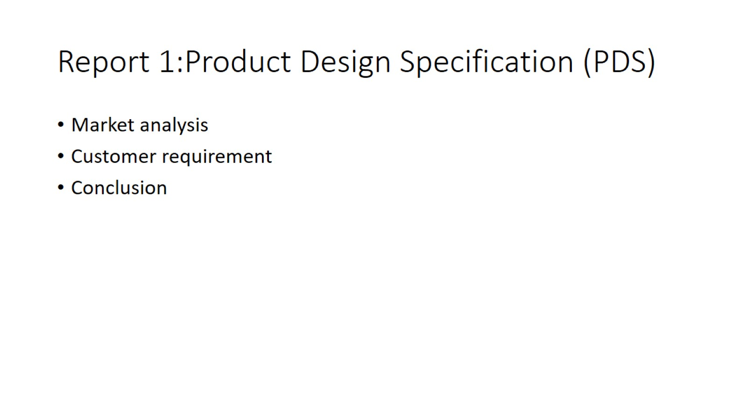
Report 1:Product Design Specification (PDS)

Slide 5
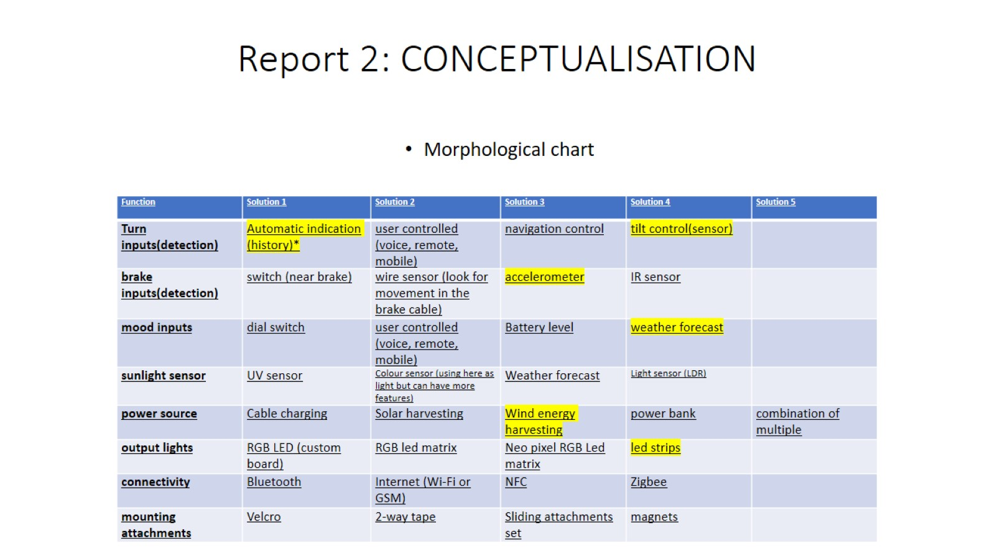
Report 2: CONCEPTUALISATION

Slide 6
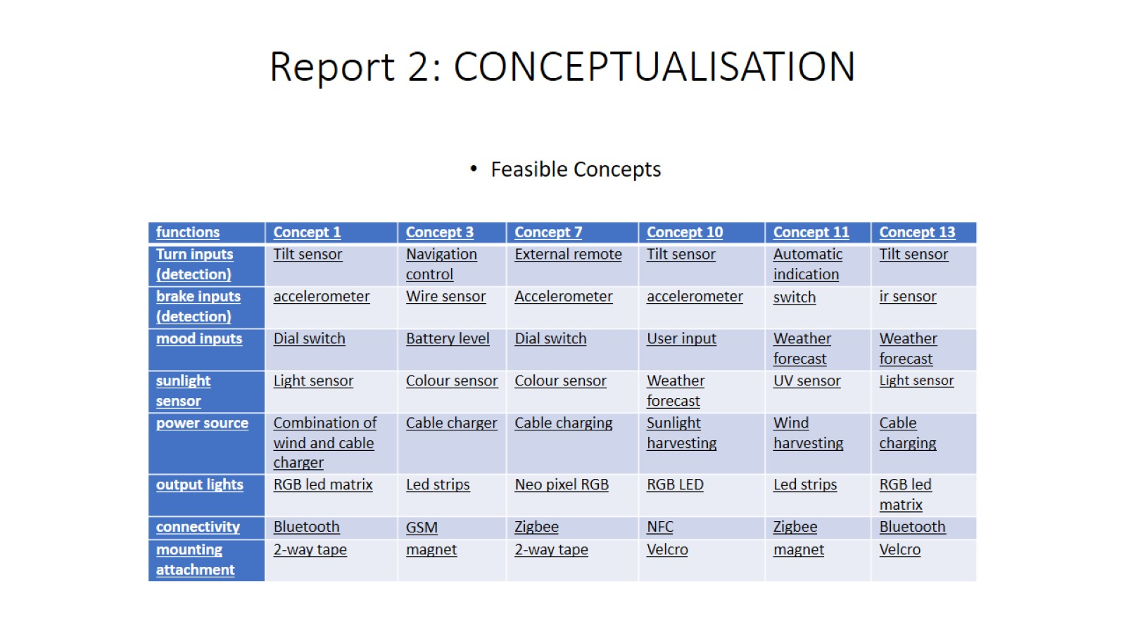
Report 2: CONCEPTUALISATION

Slide 7
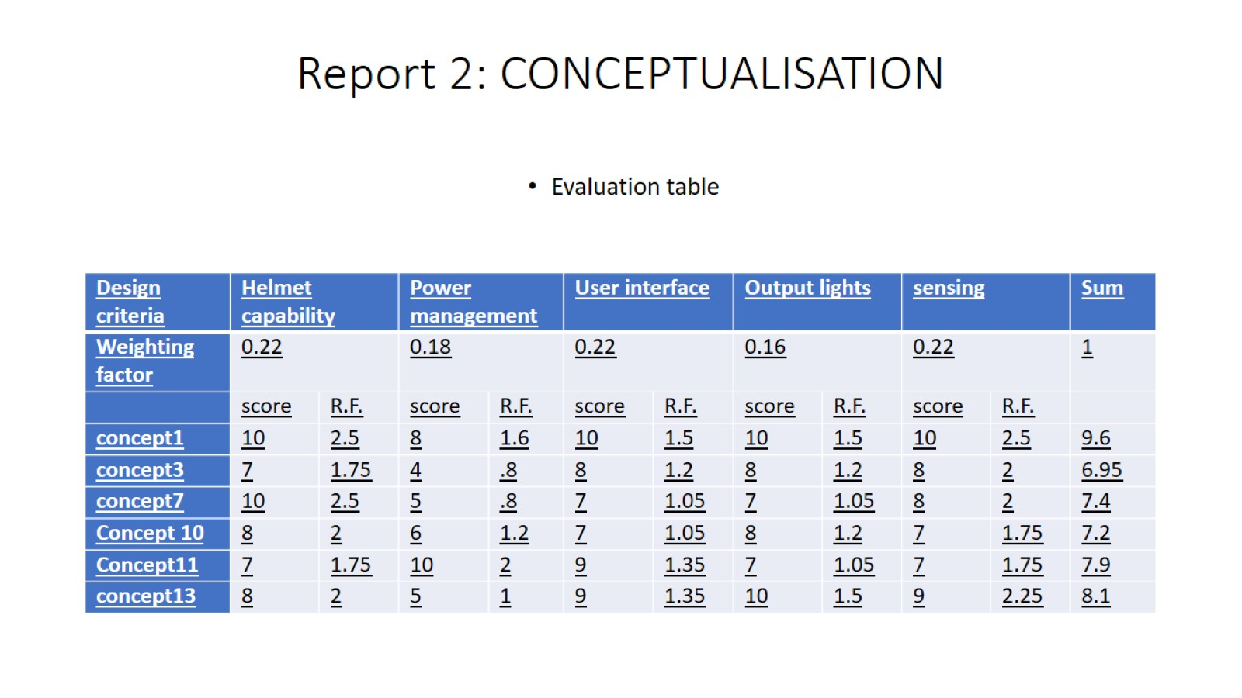
Report 2: CONCEPTUALISATION

Slide 8
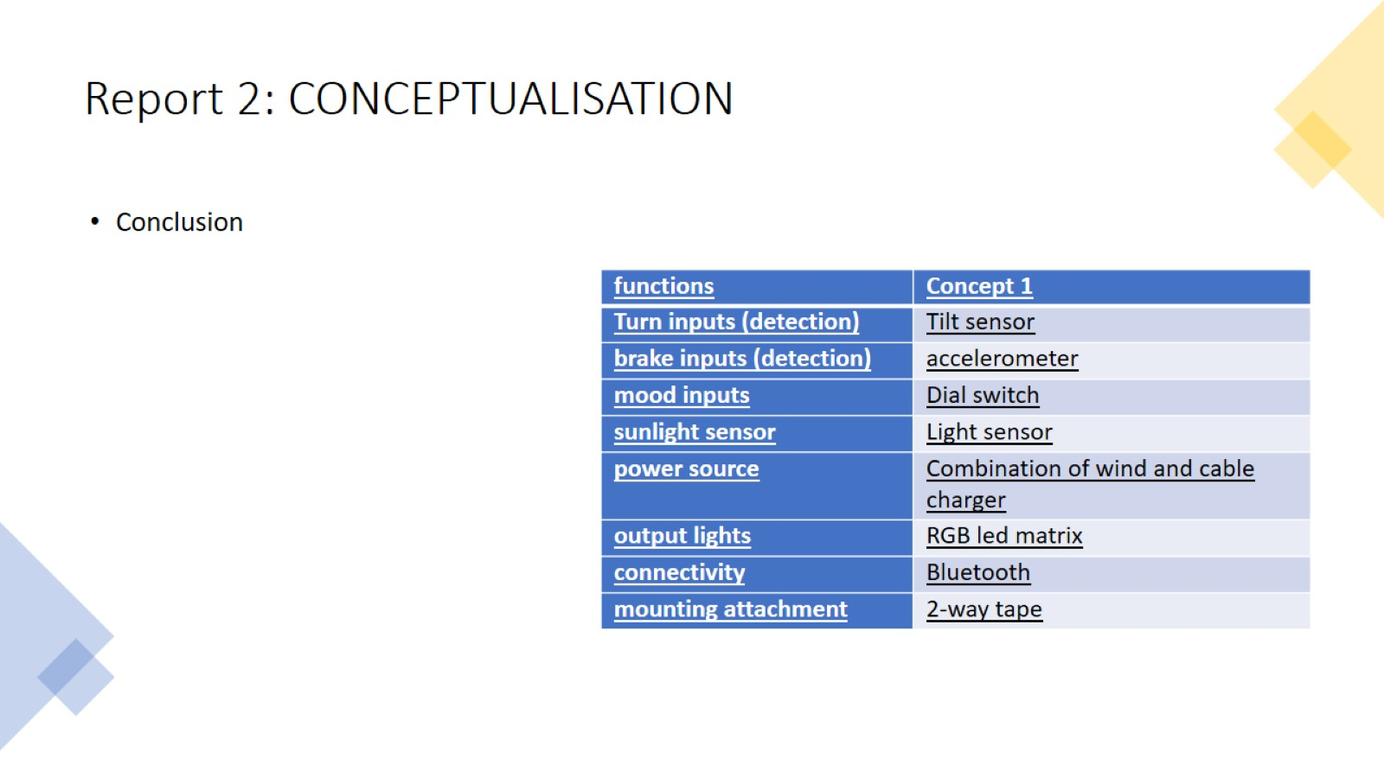
Report 2: CONCEPTUALISATION

Slide 9
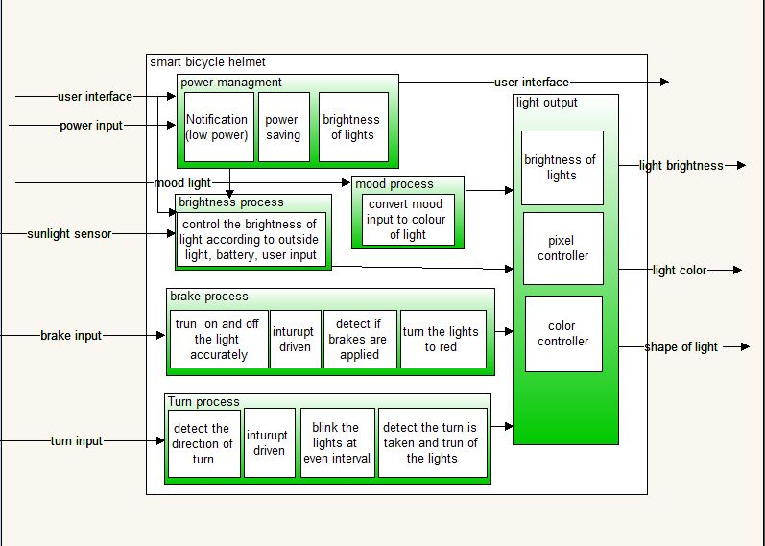
White box

Slide 10
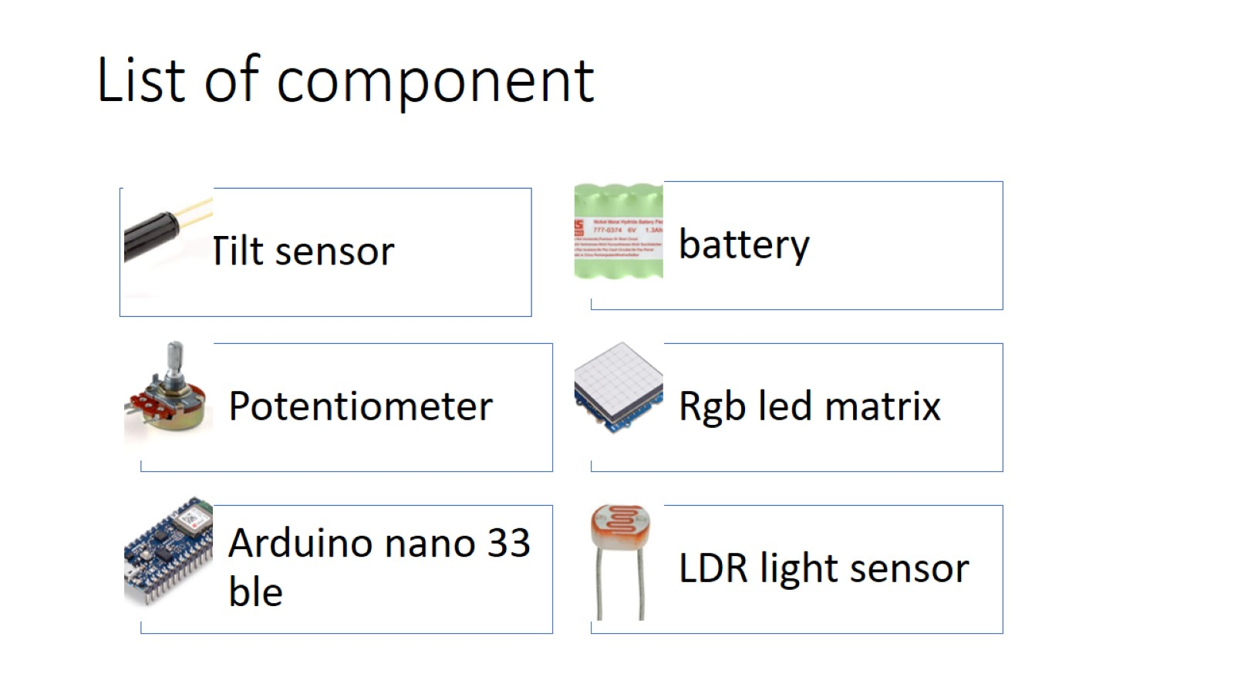
List of component

Slide 11
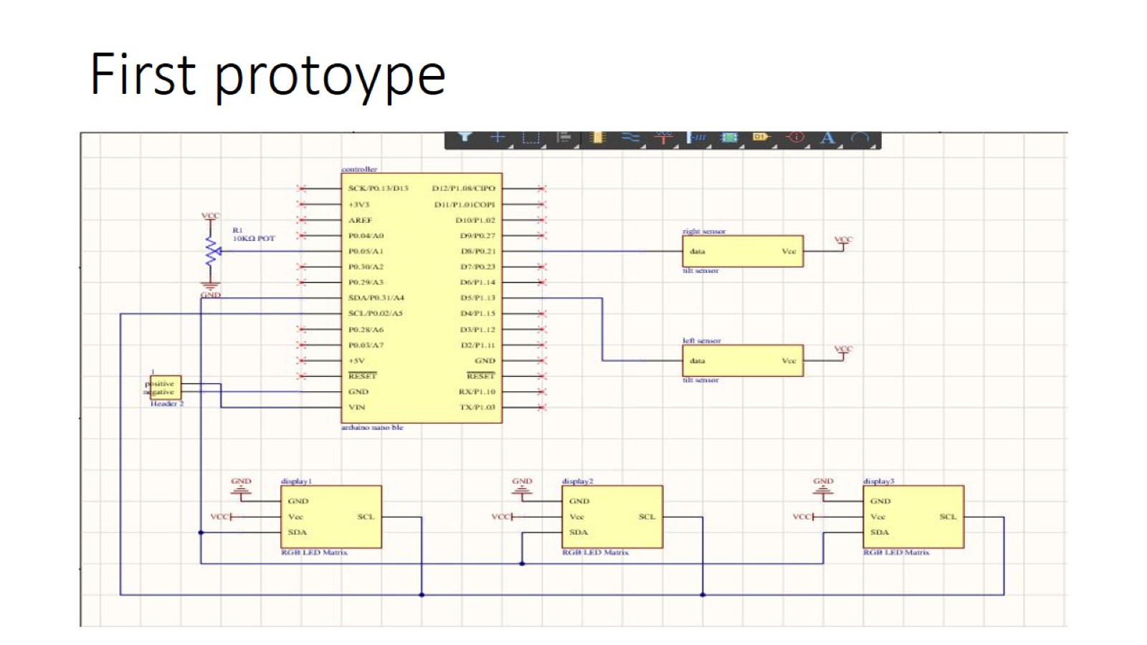
First protoype

Slide 12
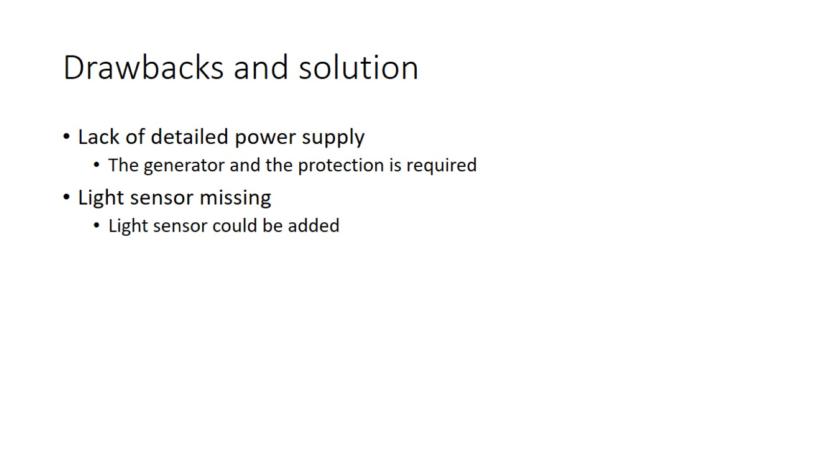
Drawbacks and solution

Slide 13
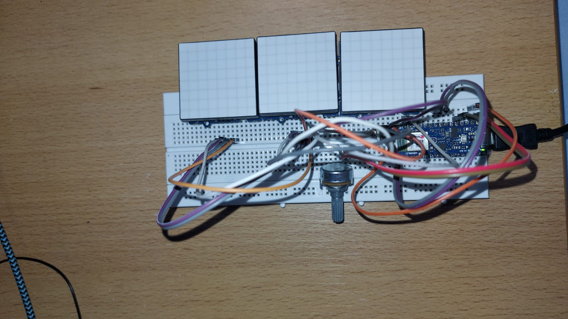
Second prototype

Slide 14
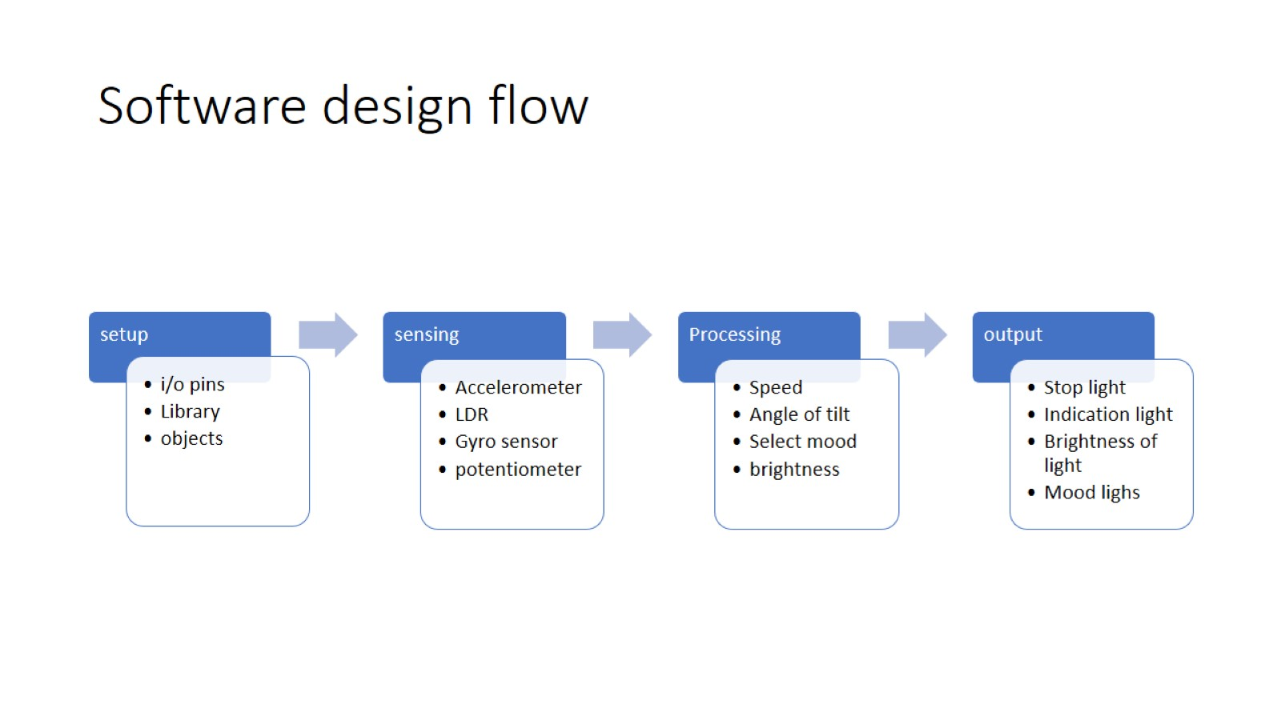
Software design flow

Slide 15
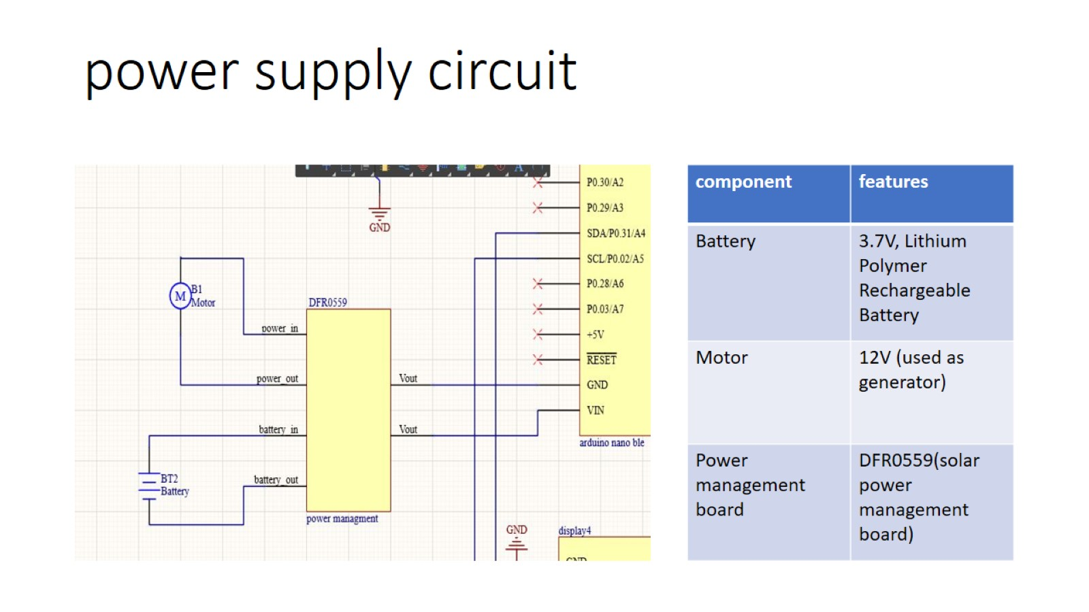
power supply circuit

Slide 16
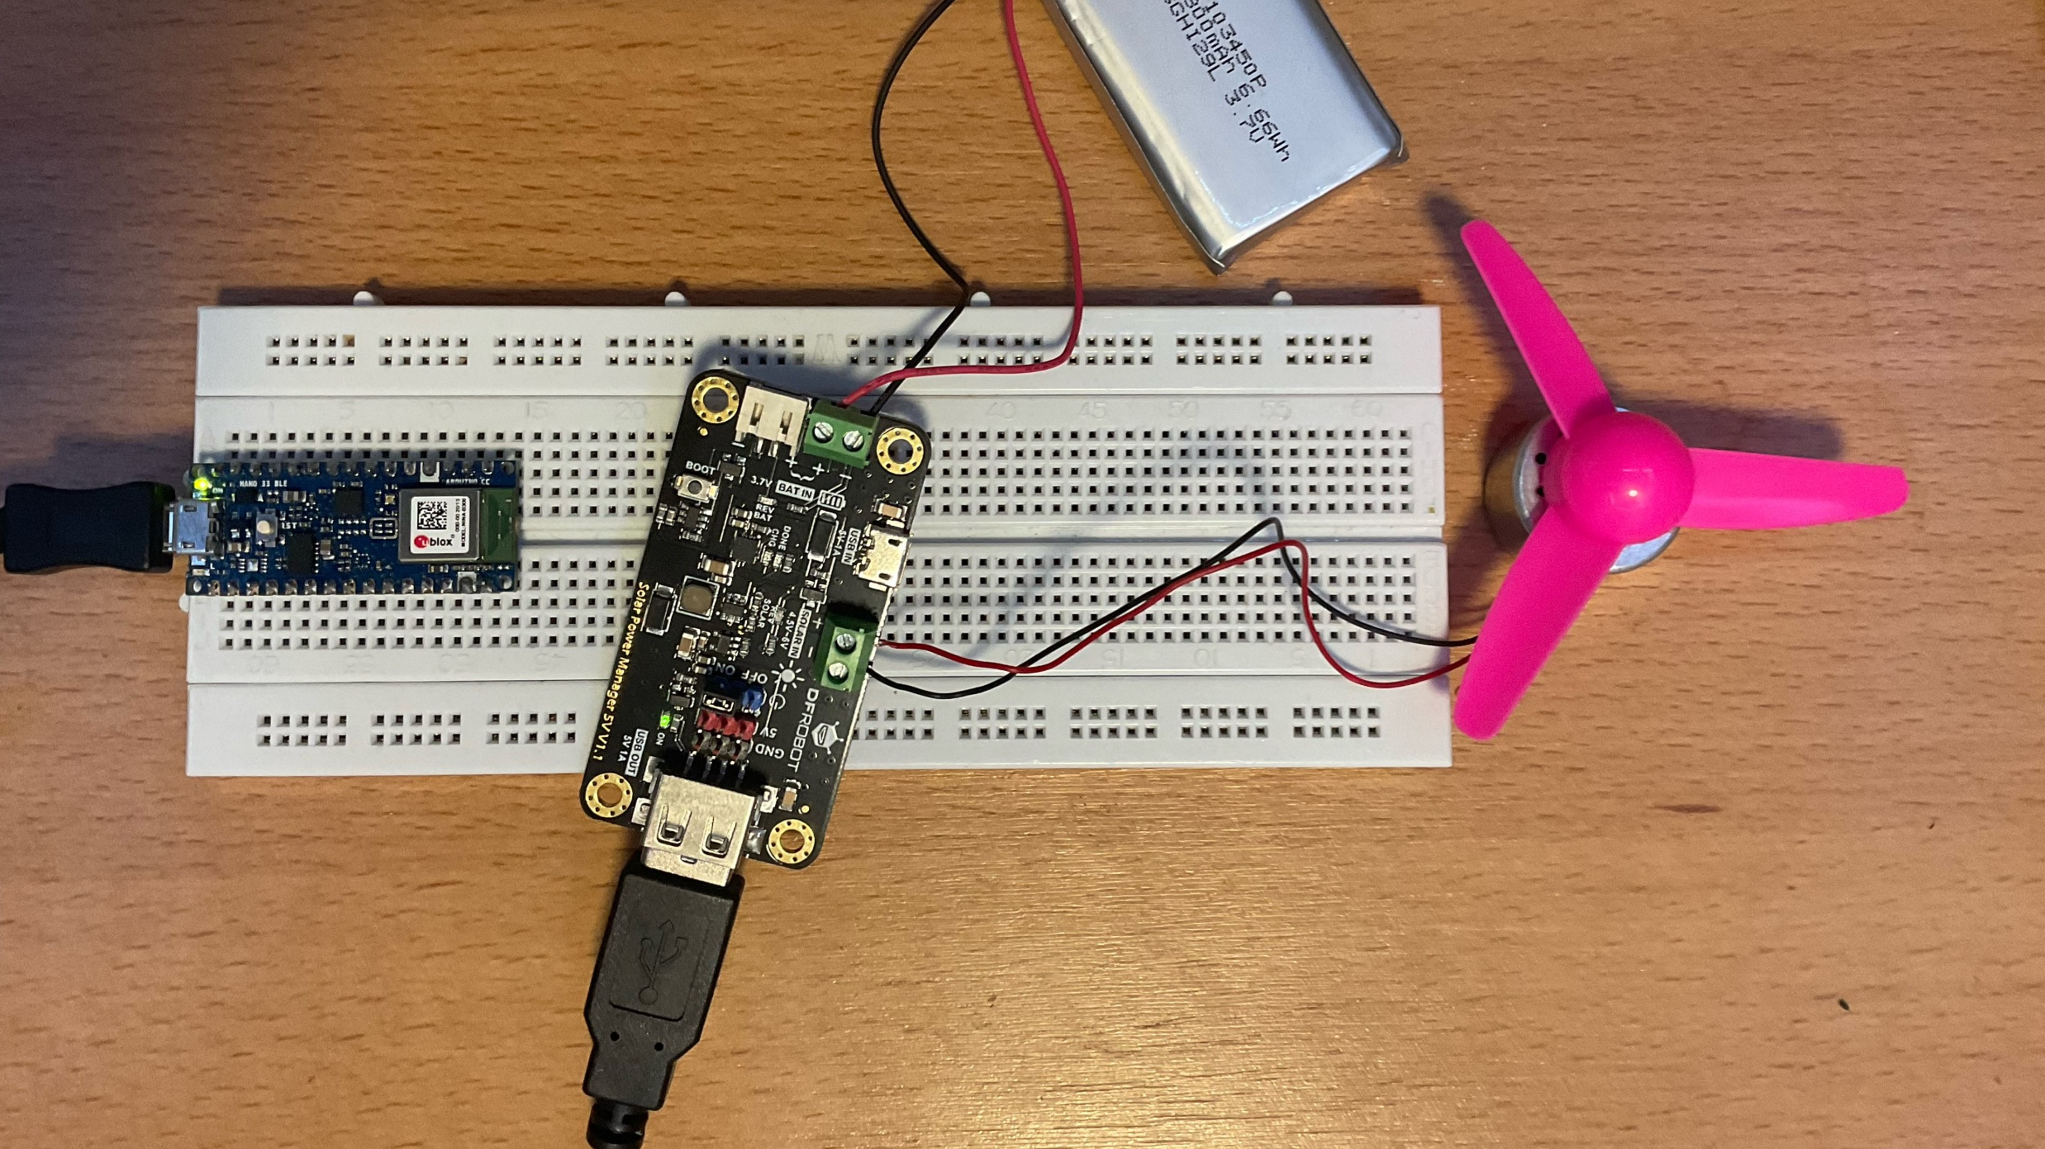
Power supply

Slide 17
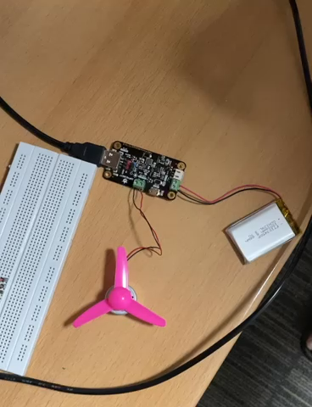
Working model of power supply

Slide 18
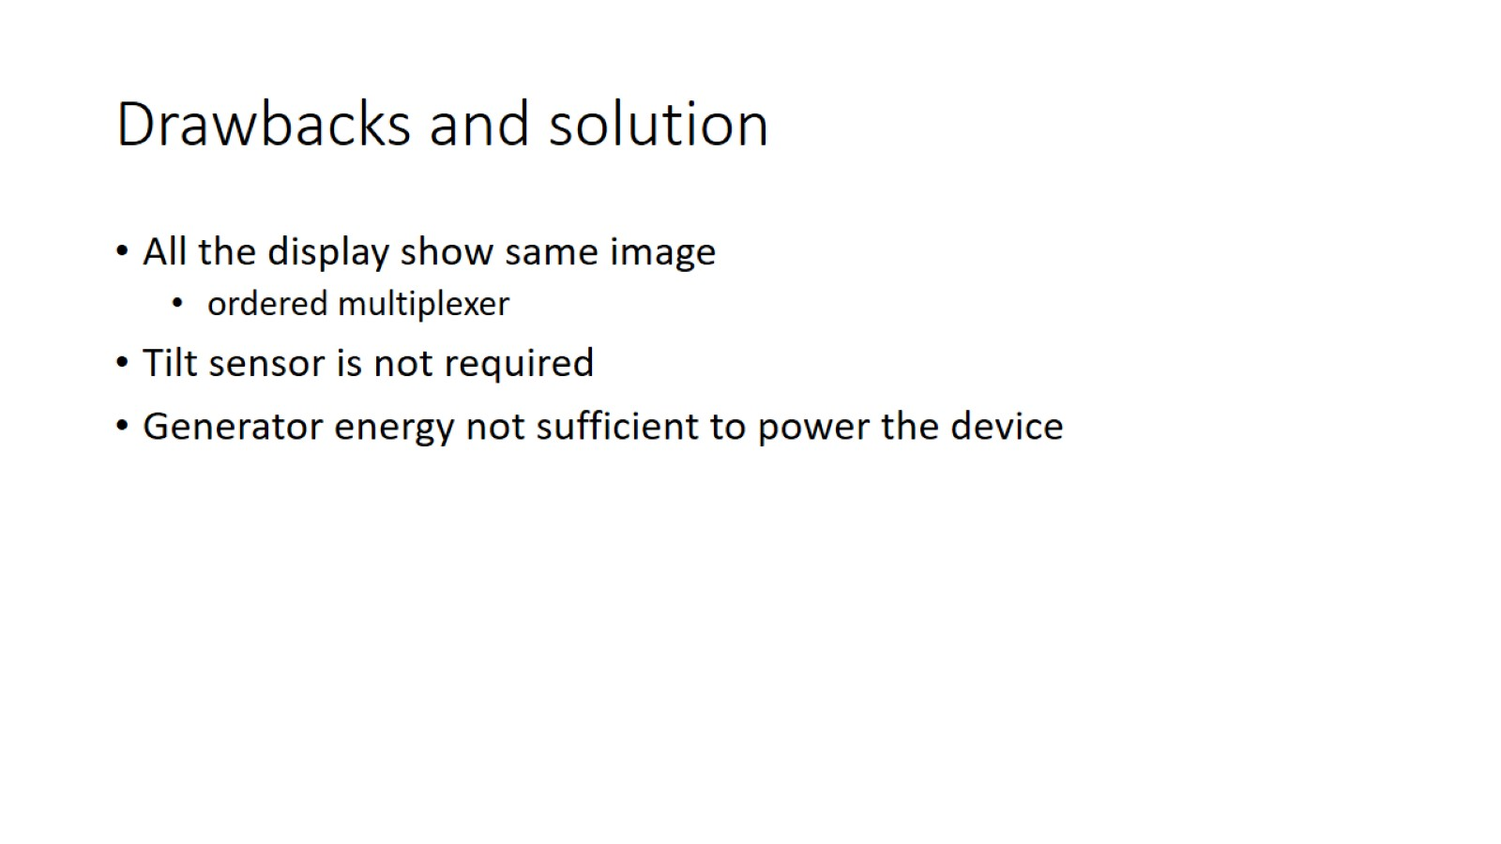
Drawbacks and solution

Slide 19
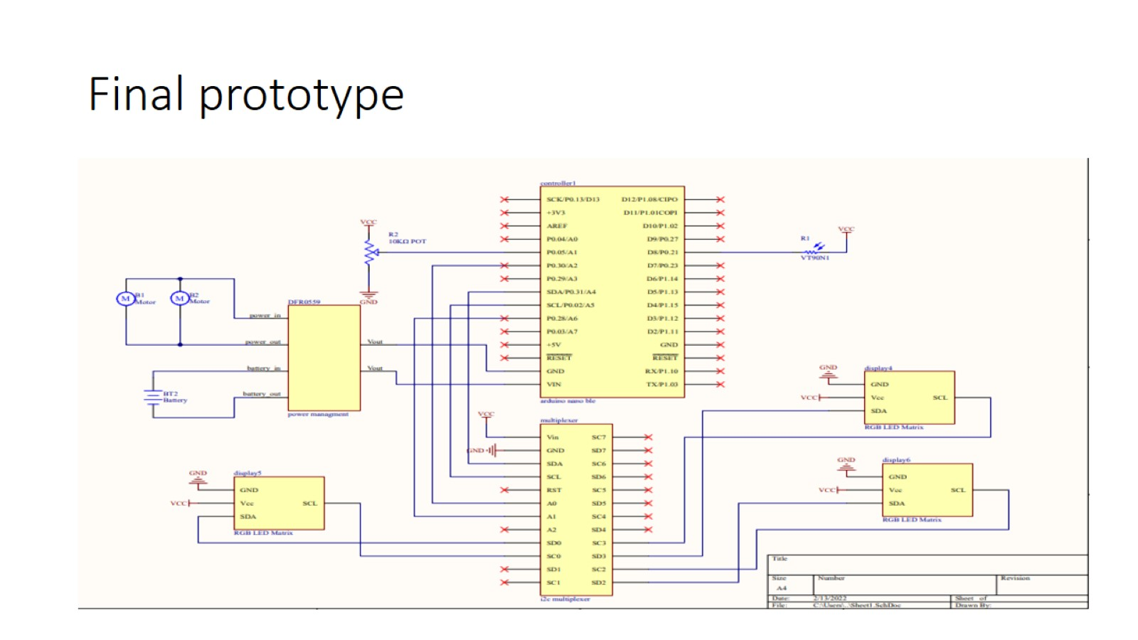
Final prototype

Slide 20
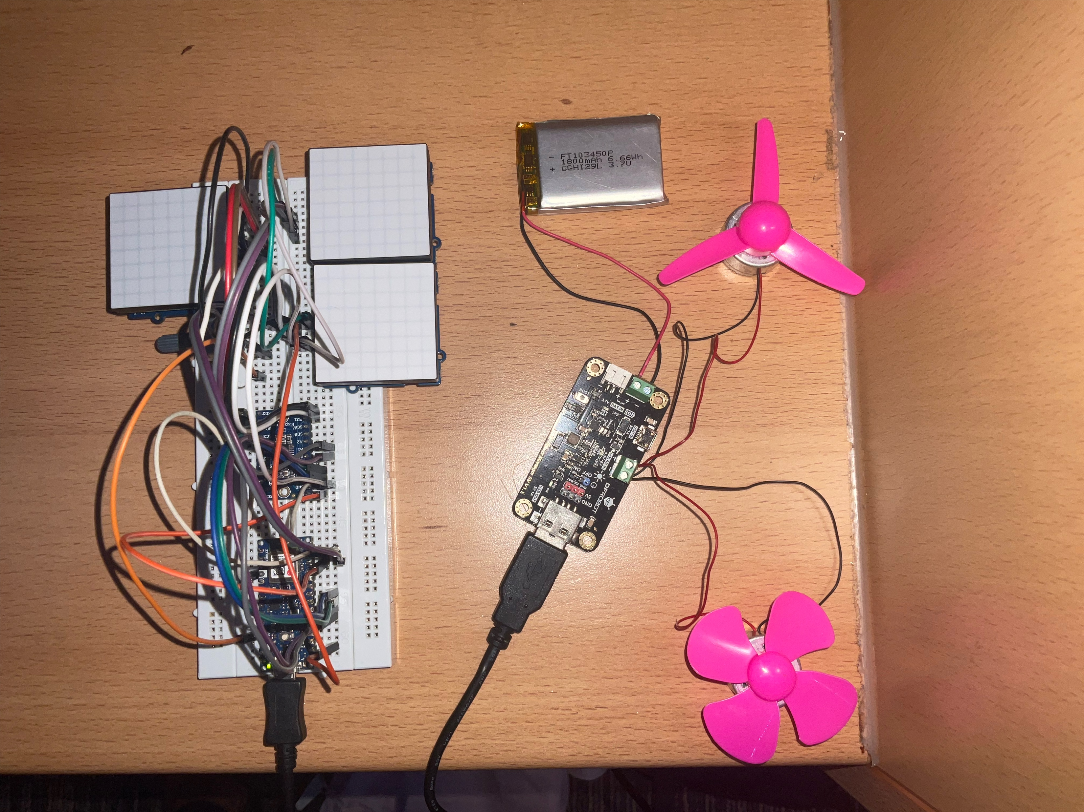
Final design

Slide 21
Conclusion
Learn about engineering skills
Got familiar with design process
Finding solutions to real life challenges
Power supply management
Coding

Slide 22
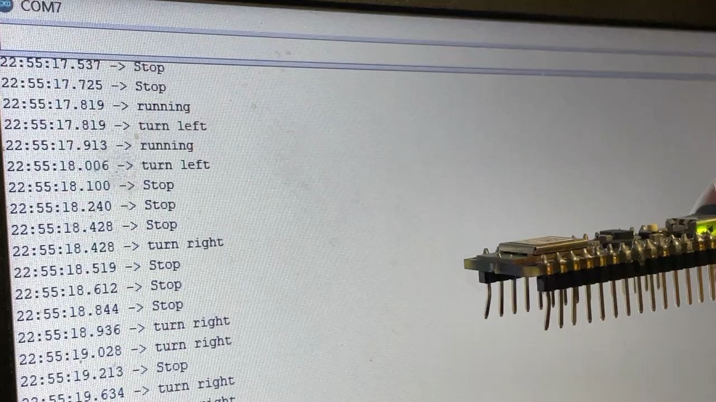
Video demonstration of sensing phase

Slide 23
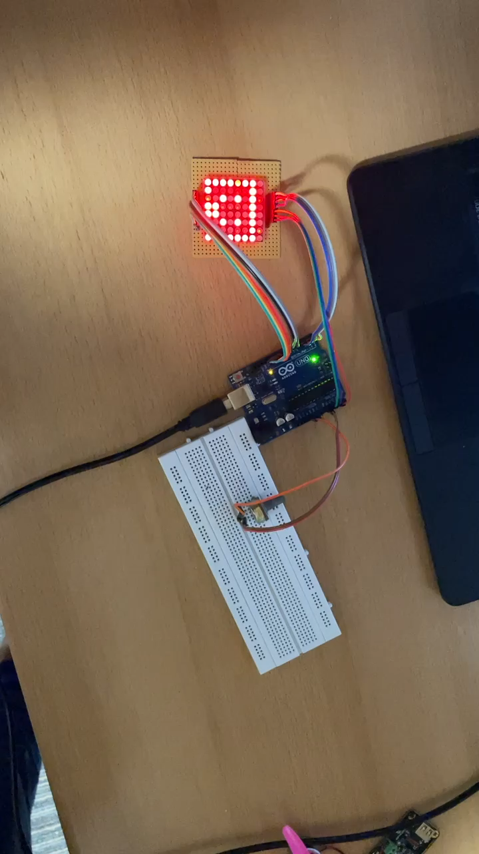
Video demonstration of mood input and matrix display

Slide 24
Thank you
Appendix
PDS
Specification
List OF COMPONENTS
schematic

